Slide 1
Customer Segmentation
Using Python
P. Ramakrishna

Slide 2
Problem statement
Customer Segmentation is a popular application of unsupervised learning. Using
clustering, identify segments of customers to target the potential user base. They divide
customers into groups according to common characteristics like gender, age, interests,
and spending habits so they can market to each group effectively.
Use K-means clustering and also visualize the gender and age distributions. Then analyze their annual incomes and spending scores.

Slide 3
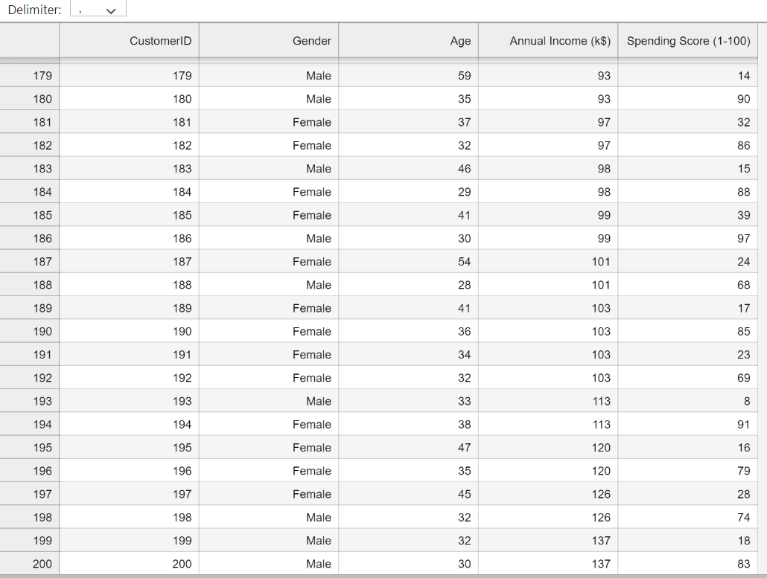
DataSet
https://drive.google.com/file/d/19BOhwz52NUY3dg8XErVYglctpr5sjTy4/view

Slide 4
Abstract
Today's business run based on such innovation having ability to enthral the customers with the products, but with such a large raft of products leave the customers confounded, what to buy and what to not and the companies are nonplussed about what section of customers to target to sell their products. This is where machine learning comes into play, various algorithms are applied for unravelling the hidden patterns in the data for better decision making for the future. This elude concept of which segment to target is made unequivocal by applying segmentation. The process of segmenting the customers with similar behaviours into the same segment and with different patterns into different segments is called customer segmentation. In this paper, clustering algorithms (k-Means) are been implemented to segment the customers and finally compare the results of clusters obtained from the algorithms. A python program has been developed and the program is been trained by applying standard scaler onto a dataset having two features of 200 training sample taken from local retail shop. Both the features are the mean of the amount of shopping by customers and average of the customer's visit into the shop annually. By applying clustering, 5 segments of cluster have been formed labelled as Careless, Careful, Standard, Target and Sensible customers. However, two new clusters emerged on applying mean shift clustering labelled as High buyers and frequent visitors and High buyers and occasional visitors.

Slide 5
Introduction
We are using K-means Clustering Algorithm and Solving the Best methods using Elbow method and Validating the method Best way.
K-Means : Clustering and Analyses using.
Elbow method is Finding best K- Value
Silhouette is Validating the Method K-Value

Slide 6
Existing Method
Elbow Method
Elbow method gives us an idea on what a good k number of clusters would be based on the sum of squared distance (SSE) between data points and their assigned clusters’ centroids. We pick k at the spot where SSE starts to flatten out and forming an elbow. We will use the geyser dataset and evaluate SSE for different values of k and see where the curve might form an elbow and flatten out.

Slide 7

Proposed method
Elbow Method is Finding the Number of Cluster’s on Data set. But That cluster’s is We are Validating the Silhouette Analysis Method it is Best K choosing.
Silhouette Analysis Validating Method
Silhouette analysis can be used to determine the degree of separation between clusters. For each sample:
Compute the average distance from all data points in the same cluster (ai).
Compute the average distance from all data points in the closest cluster (bi).
Compute the coefficient:

Slide 8
Requirements
System Requirements:
8GB RAM
120 GB ROM
I3 5th
Chrome Browser
Jupyter-Notebook
Python

Slide 9
Methodology
k-means is one of the simplest unsupervised learning algorithms that solve the well-known clustering problem. The procedure follows a simple and easy way to classify a given data set through a certain number of clusters (assume k clusters) fixed apriority. The main idea is to define k centres, one for each cluster. These centres should be placed in a cunning way because of different location causes different result. So, the better choice is to place them as much as possible far away from each other. The next step is to take each point belonging to a given data set and associate it to the nearest canter. When no point is pending, the first step is completed, and an early group age is done. At this point we need to re-calculate k new centroids as barycentre of the clusters resulting from the previous step. After we have these k new centroids, a new binding must be done between the same data set points and the nearest new canter. A loop has been generated. As a result of this loop, we may notice that the k centres change their location step by step until no more changes are done or in other words centres do not move any more.
Silhouette Method
K-Means Clustering Algorithm Best method is Elbow method that method we are validating using one of the methods is Silhouette.

Slide 10
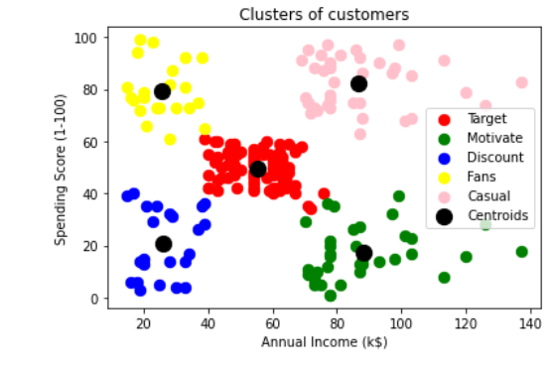
Result

Slide 11
Conclusion
Target Peoples is Red Colour marking
Motivate Peoples is Green we give these peoples Offers Attracts!
Discount Expecting Peoples we give those peoples Discount Blue colour marking.
Fans They are Spending high Amount that’s way they Regular and Fans Representing Yellow colour marking.
Casual they are high more than regular.

Slide 12


Thank You

